Slide 1
Adversarial Robustness in Machine Learning Models​
Sai Coumar, Supriya Dixit, Patrick Florendo, Nischay Uppal

Slide 2
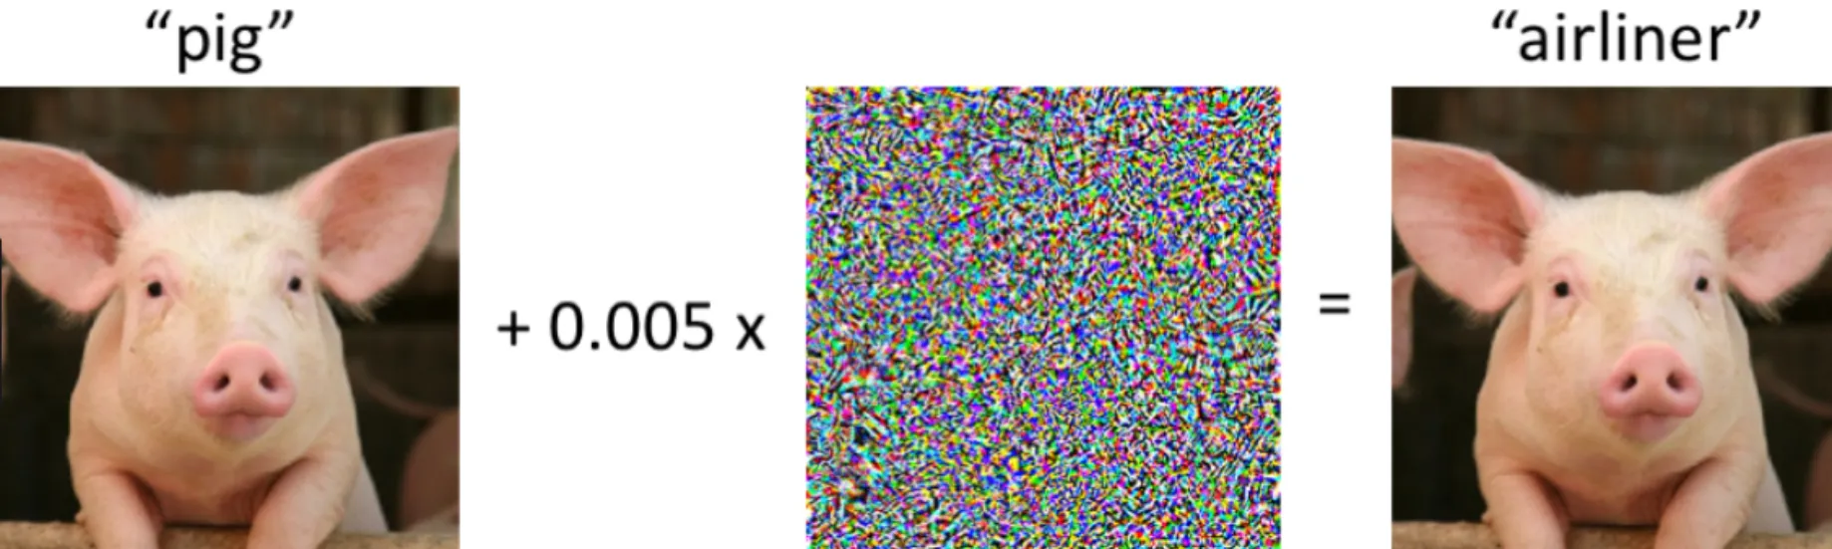
Business Goals
Current image classification models are easily tricked by minor variations that are imperceptible to the human eye
Develop robust machine learning models that can withstand adversarial attacks with minimal misclassifications
Real world application: image recognition for security purposes
Understand + implement attacks -> develop adversarial datasets to train models for maximum robustness

Slide 3
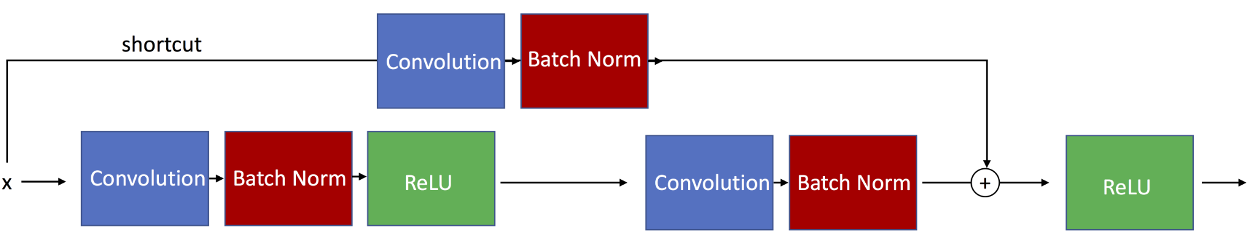
Control Model: ResNet18
Popular Deep Convolutional Neural Network
Uses skip connections and residual blocks to prevent vanishing gradient
Hyperparameters: Batch Size = 256, Adam Optimizer (lr=1e-3), 20 Epochs, StepLR scheduler
Performance prior to Attacks:
MNIST: ~99%
CIFAR10: ~78%
SVHN: 93%
Training Time: 4-10 minutes locally, Impossible on Scholar Cluster
https://github.com/rasbt/deeplearning-models/blob/master/pytorch_ipynb/cnn/cnn-resnet18-mnist.ipynb

Slide 4
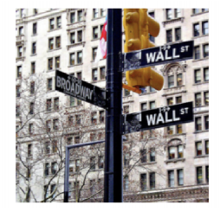
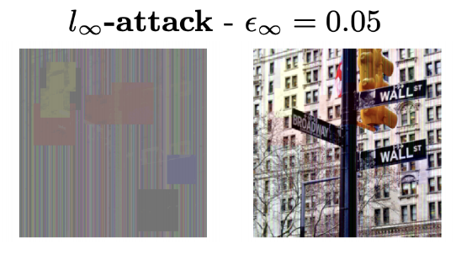
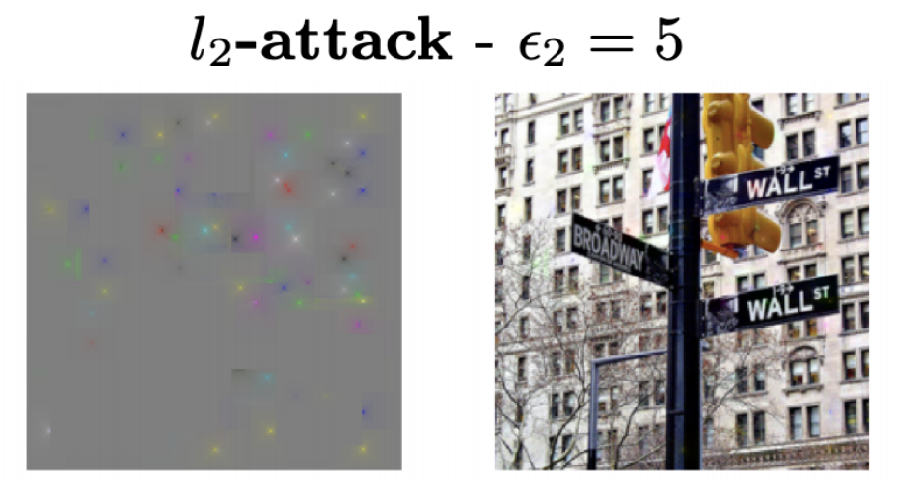
Additions: Square Attack
Black box attack
manipulates square-shaped regions in the feature space to generate adversarial examples
Regions chosen and updated on a schedule
L∞ version
Hyperparameters
epsilon which is the l_{p}-radius i.e. max perturbation size
Projected gradient descent (think constrained to some epsilon ball around starting point)
Maximum allowable attack
P_innit: starting size of the region that is updated on a schedule
Square attack is query efficient
Other black box attacks query models way more times w/ success rate way lower than white box attacks

Slide 5
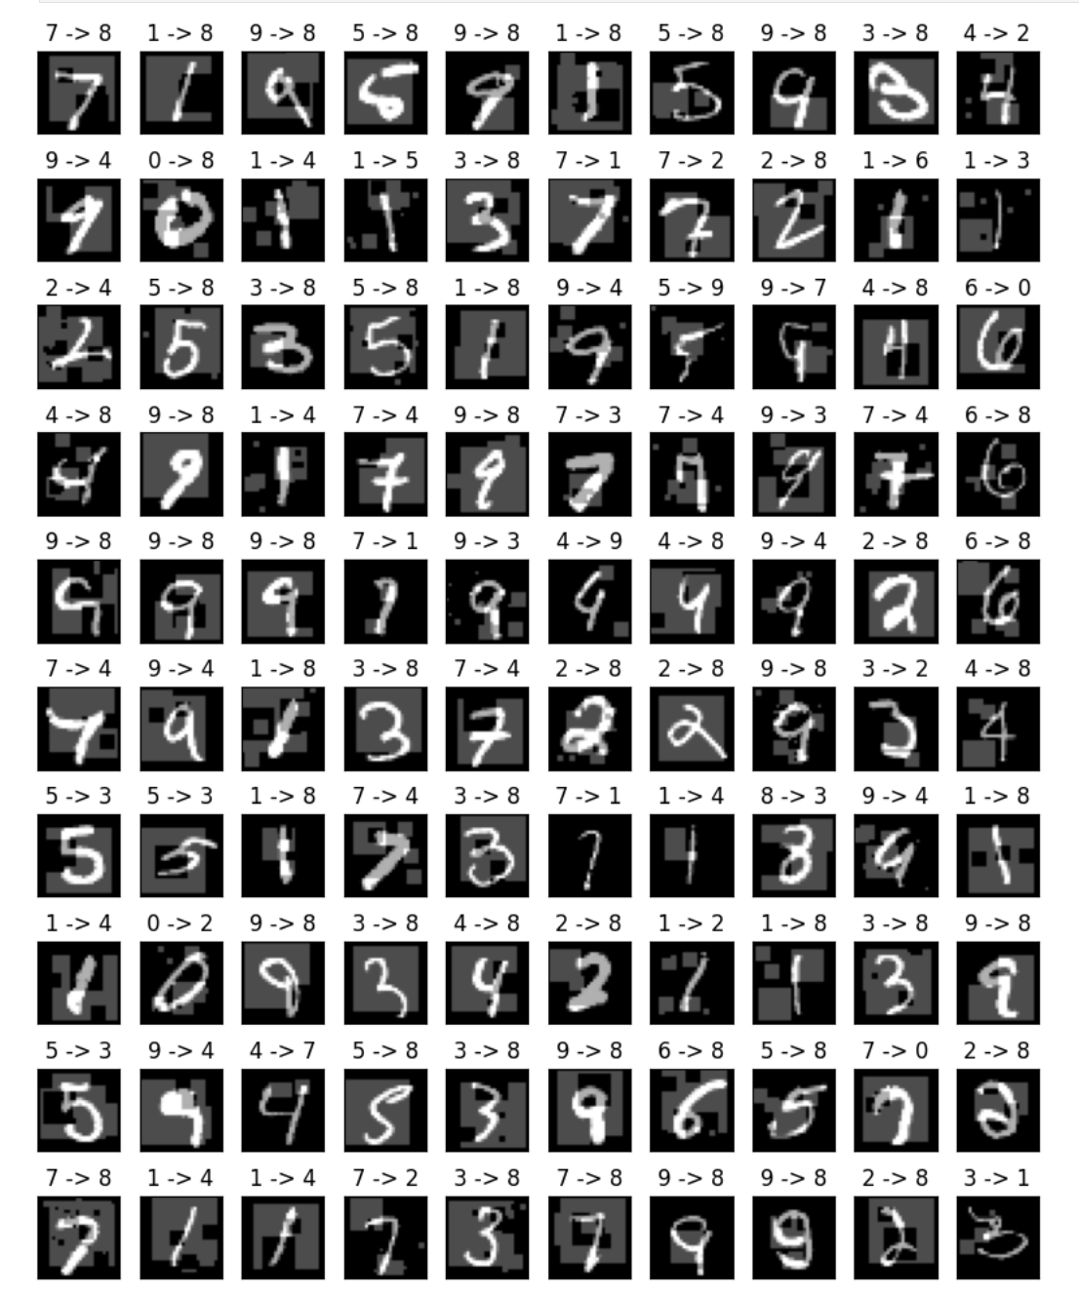
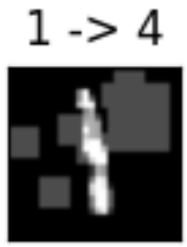
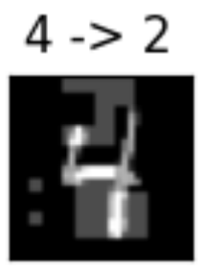
Square Attack
on MNIST
Accuracy: 59.375000 %

Slide 6
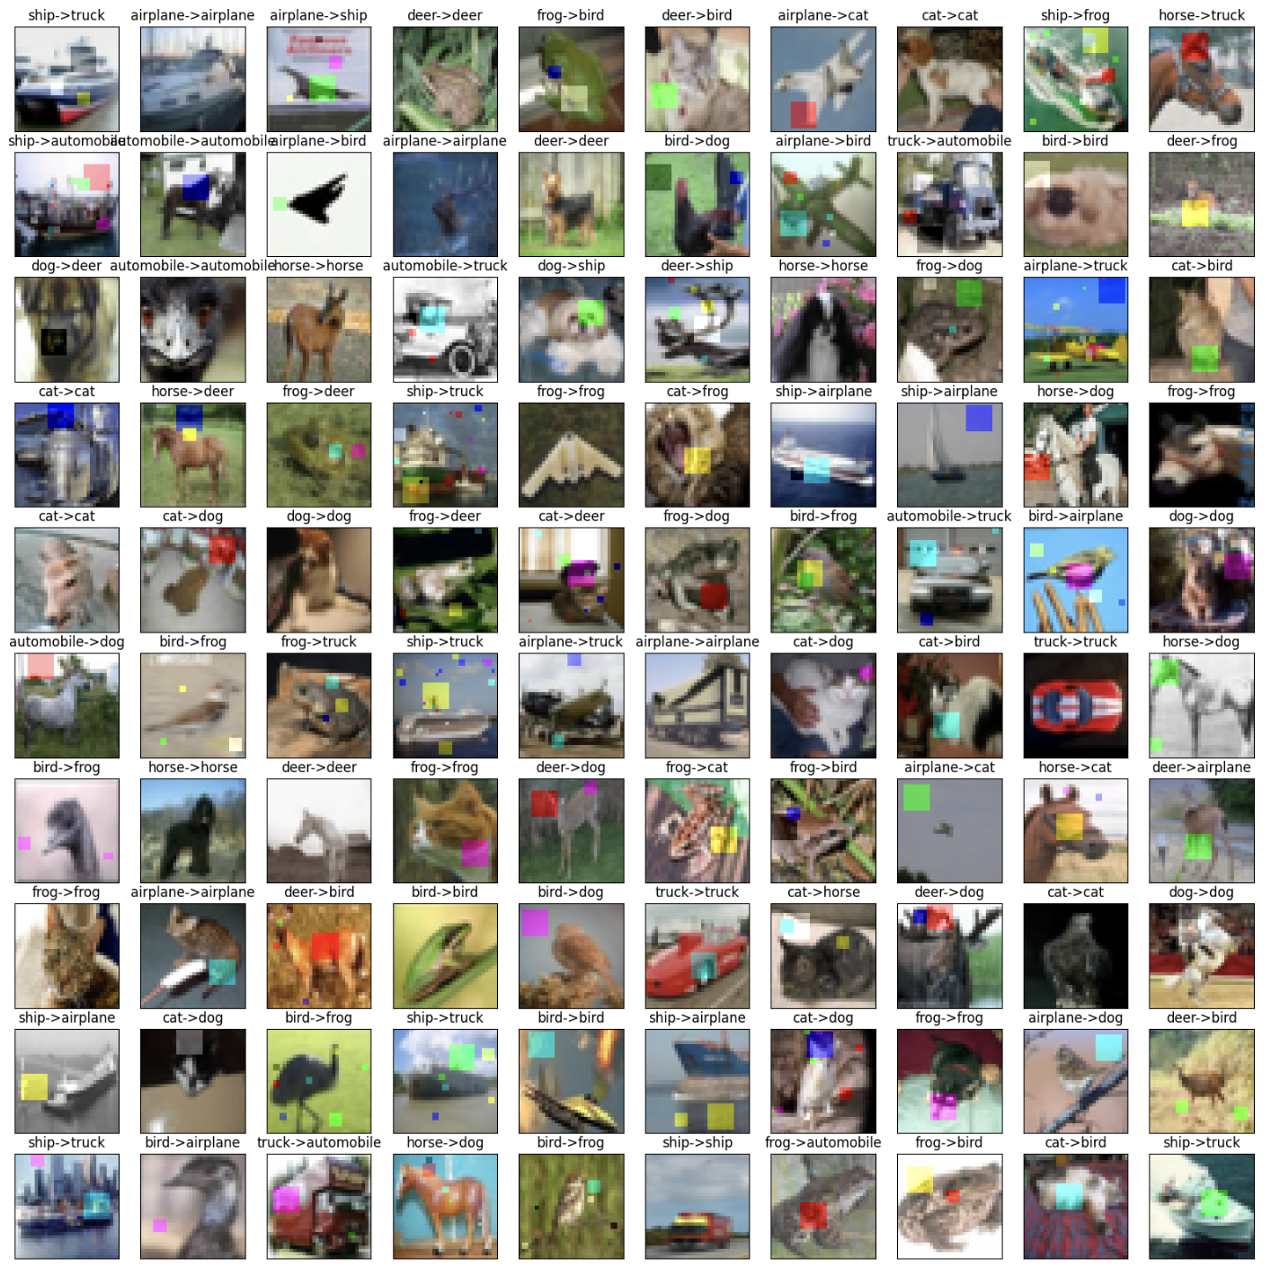
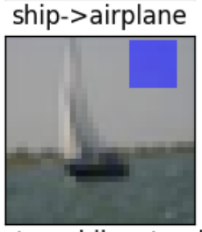
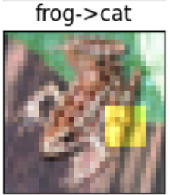
Square Attack
on CIFAR10
Accuracy: 28.906250 %

Slide 7
Adversarial attacks fully implemented and assessed
Fast Gradient Sign Method
DeepFool
Projected Gradient Descent
Carlini and Wagner
Jacobian Saliency Map Attack
Square attack

Slide 8
Changes to Testing
Iterative attack runtime was long
Adversarial attacks were tested against a batch of 256 instead of full test set
Control models were re-trained with normalized input and attacks were tested using normalized input
Functionally irrelevant for just image classification tasks due to batch normalization, but normalized input made a big difference in attack success and parameter tuning
Attacks wouldn’t be run on previously misclassified images
Targeted attacks would target class with second most confidence in classification
10 x 10 Samples to verify image retention

Slide 9
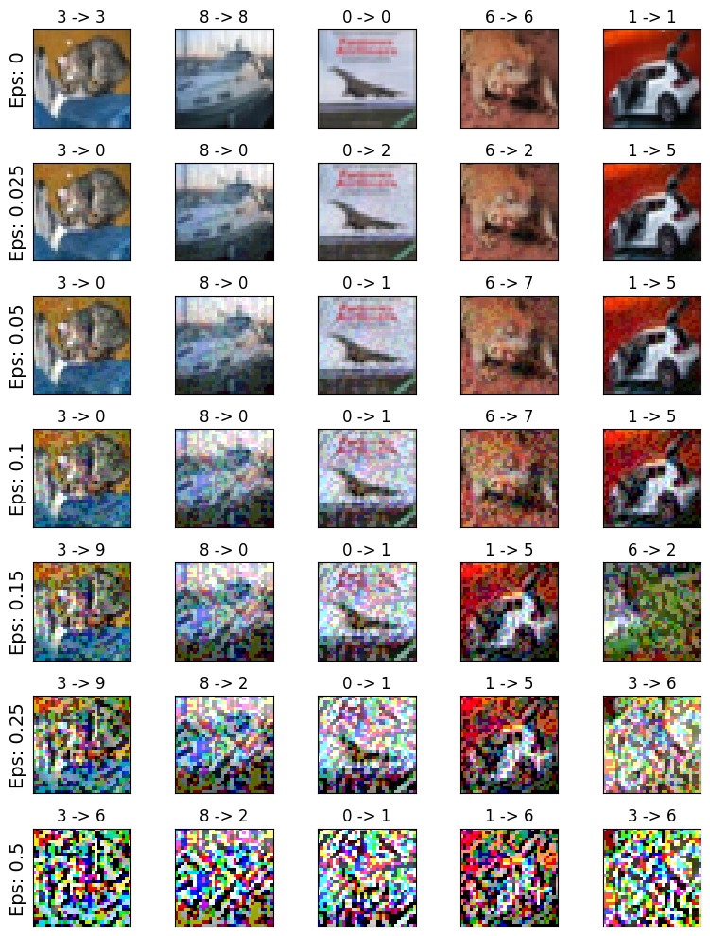
Adversarial Attack Evaluation
Adversarial Attacks come with a tradeoff between image data retention vs attack success
Point of Image Fragmentation: The attack with tuned parameters s.t. the image retains as much of the perceptible image data while minimizing accuracy.
Must be evaluated manually by humans as “perception” can not be automated.
Attacks success can vary per image with different tuned parameters.
Using the same parameters within datasets worked fine for testing, but between datasets required new tuning.
Image fragmentation occurs between 0.025 and 0.05 (FGSM on CIFAR10)

Slide 10
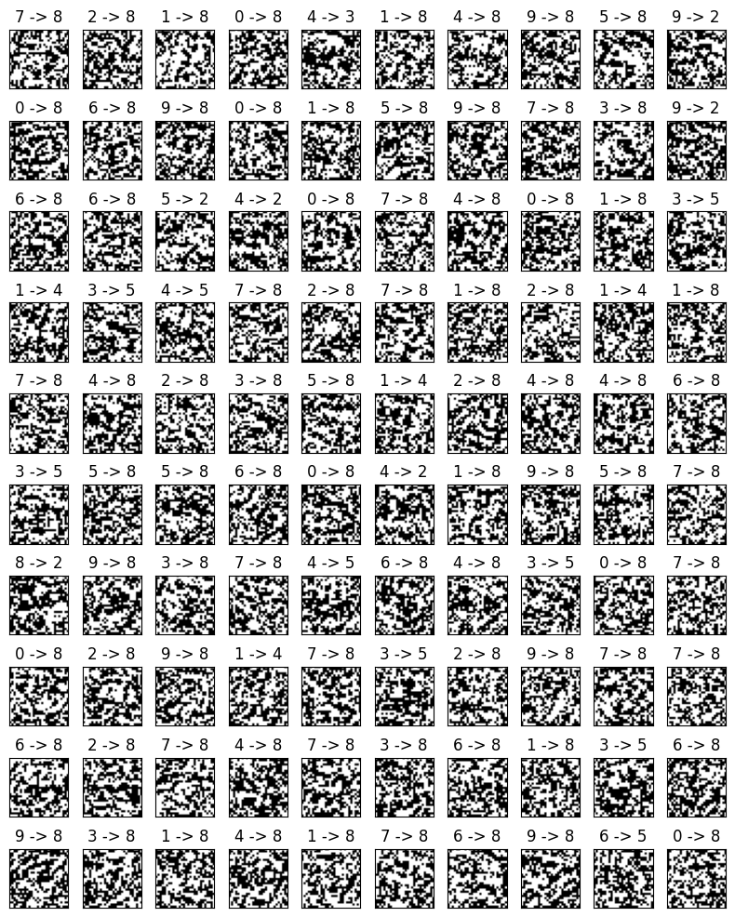
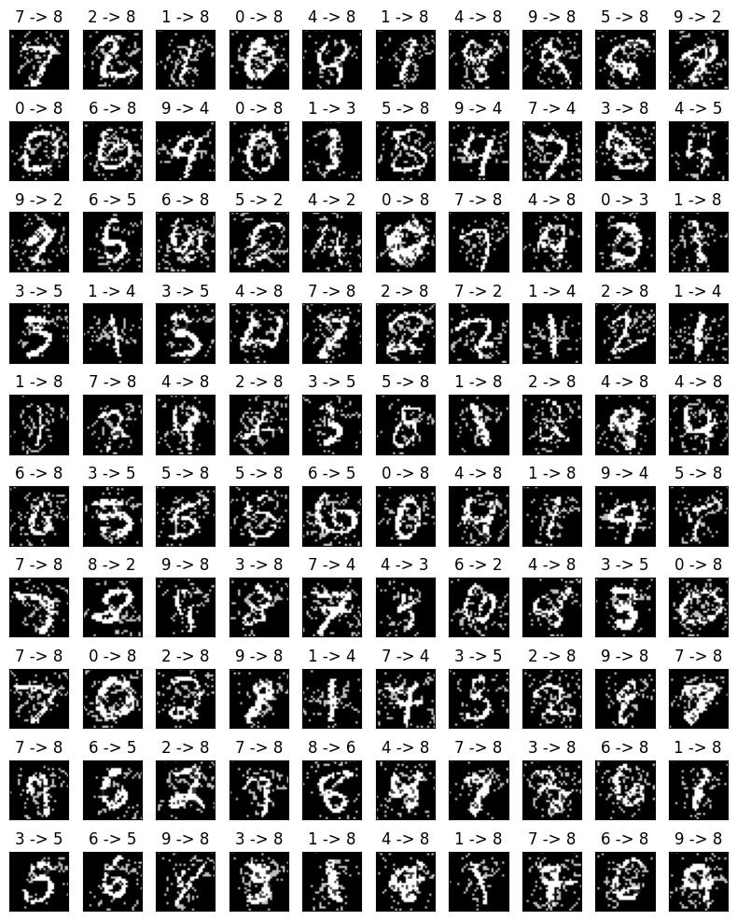
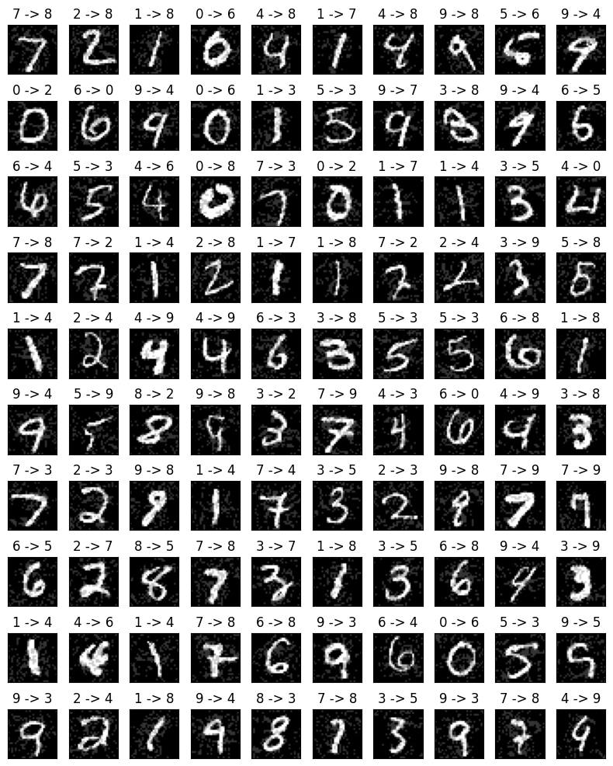
Adversarial Attack Evaluation
Samples of 100 were used to view image fragmentation change as parameters were tuned (PGD shown below)
α=1
α=.5
α=.1

Slide 11
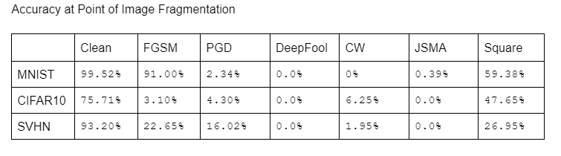

Slide 12
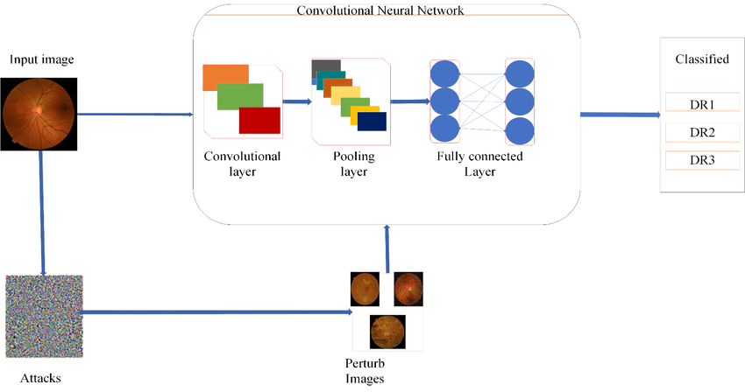
Training Robust Models
Take samples (10 batches) of adversarial input from the output of our attacks
Augment our datasets with the adversarial input
Retrain our ResNet18 models using augmented datasets
Adversarial Attack and Defence through Adversarial Training and Feature Fusion for Diabetic Retinopathy Recognition. (Lal et. al)

Slide 13
Dropping Black Box Algorithms
NES:
Could not be reproduced
Attack functionality exactly the same as Projected Gradient Descent with Gradient Estimation instead of Gradient Extraction
More computationally expensive for the same adversarial input
Constraint of inaccessibility to control model not an issue
Square Attack:
Did not perform as well as other adversarial attacks
Not as computationally expensive as white box, but cost not worth it for performance
Many iterations needed for a substantial drop in model performance
Every iteration you query the model
Paper primarily used ImageNet, more complex dataset
469x387 pixels vs 32x32 pixels for CIFAR10
Size of perturbed regions is decided in part by size of image (p_init)

Slide 14
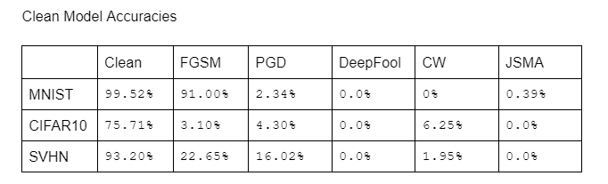
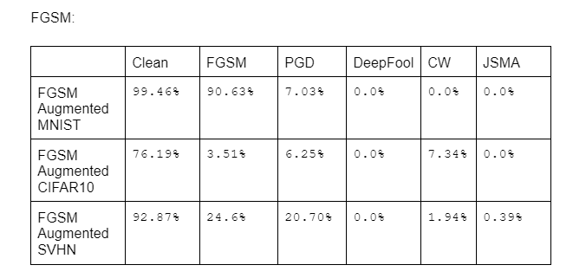

Slide 15
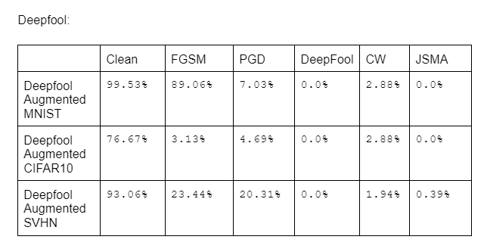

Slide 16
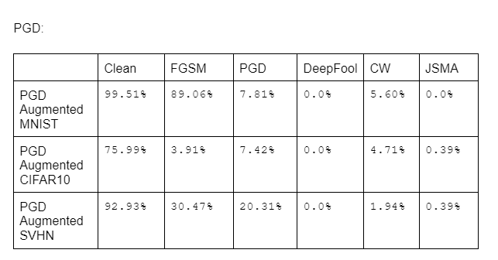

Slide 17
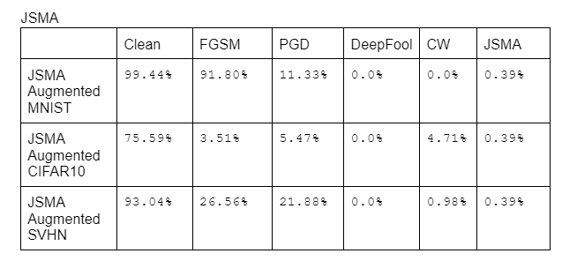

Slide 18
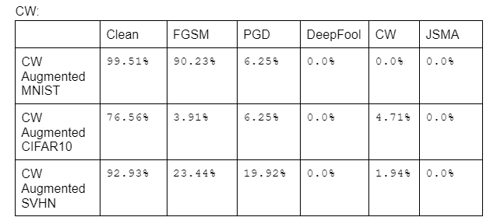

Slide 19
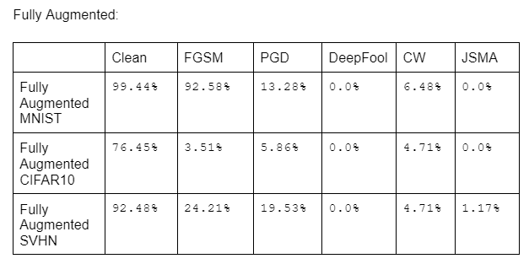

Slide 20
Key Takeaways
Model robustness/Attack effectiveness can vary from dataset to dataset
Adversarial training from a certain attack can improve robustness towards other attacks
FGSM on MNIST is somewhat resistant to adversarial training
Deepfool (the “perfect” attack) is the strongest adversarial attack and was completely insensitive to adversarial training
JSMA was similarly effective but models could be trained to be slightly more robust
Models saw the most benefits from adversarial training towards PGD attacks
Augmenting datasets with adversarial input from multiple attacks made them generally more resistant overall

Slide 21
Business Goals
Develop robust machine learning models that can withstand adversarial attacks with minimal misclassifications
Success: Fully Augmented ResNet18 models had significant increase in resistance to adversarial attacks
Understand + implement attacks -> develop adversarial datasets to train models for maximum robustness
6 adversarial attack algorithms implemented and 15 augmented datasets generated

Slide 22
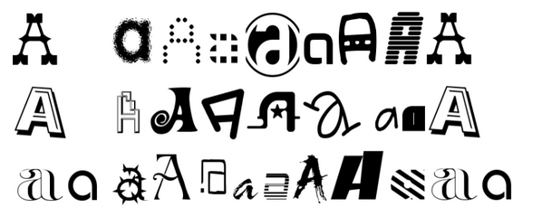
Next steps
Fine tuning + building on our black box attacks
Different norms for our existing attacks
CW: L₀ , L∞
Square: L₂
Larger Augmented Datasets
Boundary attacks
starts from a large adversarial perturbation and then seeks to reduce the perturbation while staying adversarial
Broader variety of datasets: e.g. ImageNet, notMNIST

Slide 23
Thank You!
A special thanks to Xiaoni Duan, Rajdeep Haldar, and Professor Guang Lin

